Slide 1
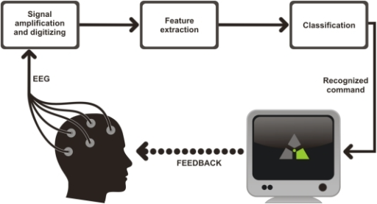
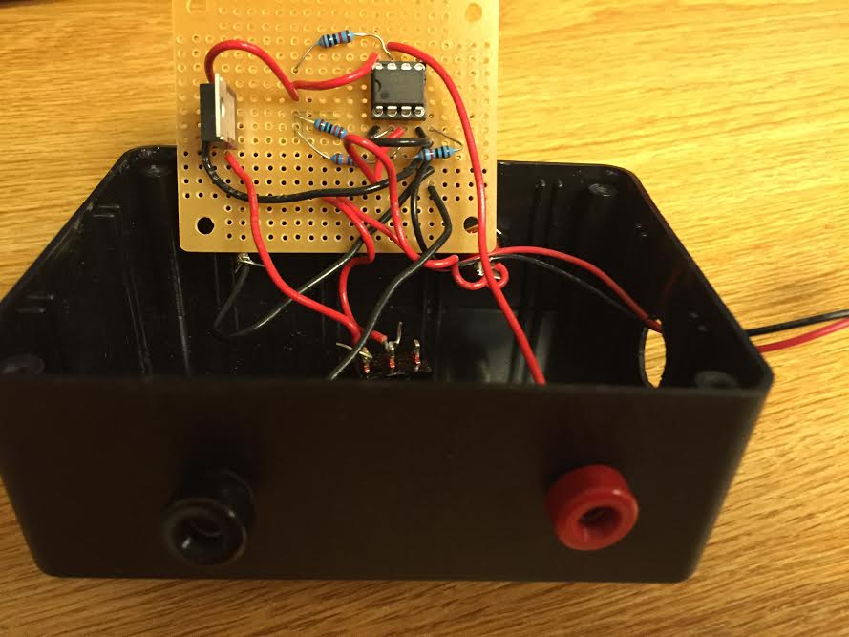
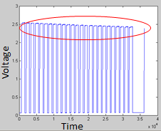
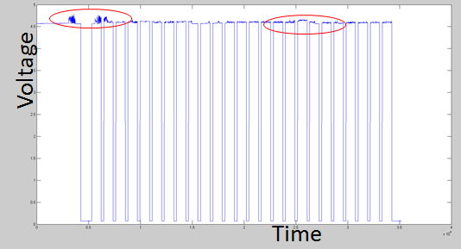
Developing Event-Related Potential Experimental Setup for Brain-Computer Interface Systems Mentee: Mythri Anumula Mentor: Jamie Norton
Signal amplification and digitization
Feature extraction
Classification
Background and Introduction:
Steady State Visually Evoked Potential and Brain-Computer Interface
When the retina is excited by frequencies between 3.5 Hz and 75 Hz, the brain responds by generating waves of the same frequency (or multiples of the same frequency)as the visual stimulus.
These signals are called steady state visually evoked potential (SSVEP), and can be detected by electroencephalography (EEG).
People who are severely immobilized due to a handicap can concentrate on one stimulus out of many to “select” one SSVEP that represents a task or a word.
In SSVEP, “stimuli” are usually black boxes on a screen that blink at different frequencies.
Existing event-related potential experimental conditions:
Existing setup was oversensitive to noise and often gathered inconsistent and consequentially useless data.
Objective: Improve on an existing experimental setup that will enable researchers to more accurately and confidently identify when a blinking visual stimuli was turned on or off.
Why is it important?
Equipment that detects EEG signals has millisecond level timing and is often very noisy.
In order to reduce noise, many trials are taken and averaged. However, if the timing of the trials is off, then the results of the experiments will be inaccurately averaged.
To combat this problem of inconsistent results, measures must be taken to increase the accuracy of trial timing.
1. Design and 3-D print a phototransistor mount to secure circuity and minimize ambient light interference
2. Improve design of phototransistor timing circuit to incorporate variable resistor that decreases sensitivity to outside noise
Examples of faulty data
3. Create a design that is sturdy and easy to access for future reference using printed circuit board
Results:
Adding a potentiometer reduced noise and made the phototransistor circuit less sensitive to ambient interference.
Using CAD software to design and 3-D printing a phototransistor mount allowed for a more stable environment that limited the amount of ambient light that skewed results.
Future Work:
Install the phototransistor circuit and test under various conditions.
Ensure that new set up is stable and can provide better data than previous set up.
Acknowledgements:
Luck, Steven. "An Introduction to the Event-Related Potential Technique." (2005): 303-32. Print.
Bobrov P, Frolov A, Cantor C, Fedulova I, Bakhnyan M, Zhavoronkov A. General scheme of an EEG-based BCI.EEG. Digital image. Brain-Computer Interface Based on Generation of Visual Images. Opeini, 2011. Web. 26 Apr. 2015.
Bretl Research Group

