Slide 1
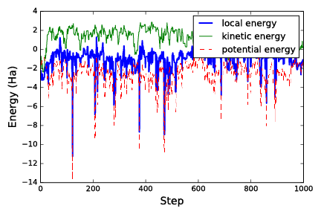
Quantum Monte Carlo
Mentee: Bradley Morrell
Mentor: Yubo Yang
Problem: In order to build or find out more information about nanoscale systems, one of the fundamental things to learn about is the different energy states of a system, especially the ground state energy.
Importance:
We cannot truly understand or use nanoscale systems without understanding their energy states.
Objective: To build a program in python that approximates an energy state of a trial wave function using Variational Monte Carlo. Then utilize this knowledge to find the ground state of a system using Diffusion Monte Carlo.
We have a trial wave function, we want to approximate the energy of our system which behaves according to the function. Using the Metropolis Algorithm, we can easily generate random samples from the probability distribution of the wave function without normalizing it. We then find the local energy of that sample coordinate position. We can then generate a list of energies and find the mean of those energies, which is the approximate energy of our trial wave function for our system by way of using Monte Carlo Integration.
We have to solve the Shrodinger equation for our system. This means finding a many body wave function on a many body Hilbert space that can solve the Shrodinger equation. We can use Variational Monte Carlo to approximate the energy of a trial wave function for our system. Then we can try to optimize the trial wave function and get an energy closer to the ground state of our system. Diffusion Monte Carlo takes this one step further by actually getting a function that has the ground state energy.
Progress: Completed the Variational Monte Carlo implementation in Python.
Worked on solving the diffusion equation and learned about how diffusion Monte Carlo behaves.
I implemented this in Python using a gaussian function for a trial wave function, moving a point randomly in a box of 1.5 to -1.5 x and 1.5 to -1.5 y, and the local energy is just $\frac{(({−∇^{2}}/2+V)Ψ)}{Ψ}$ of the wave function! I used the Metropolis Algorithm to generate samples and generate a table of their corresponding energies.
Skills and Knowledge Gained:
Learned much more about how Monte Carlo methods work.
Learned much more about quantum systems.
Learned much more about how to apply my knowledge of differential equations and linear algebra.
Gained more experience with Python and Latex.
Future Work:
Finishing my implementation of diffusion Monte Carlo.

