Slide 1
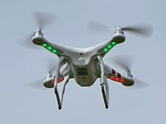
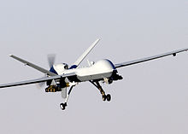
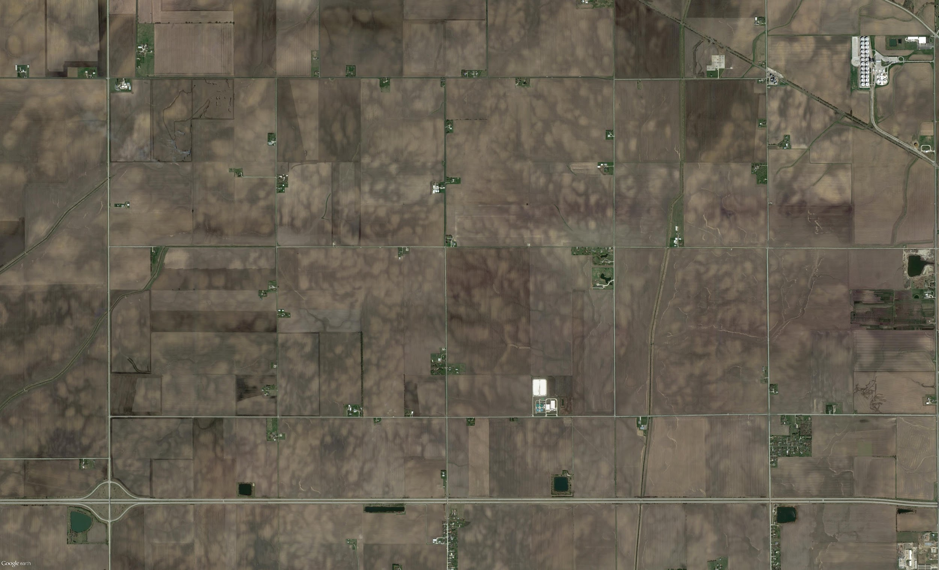
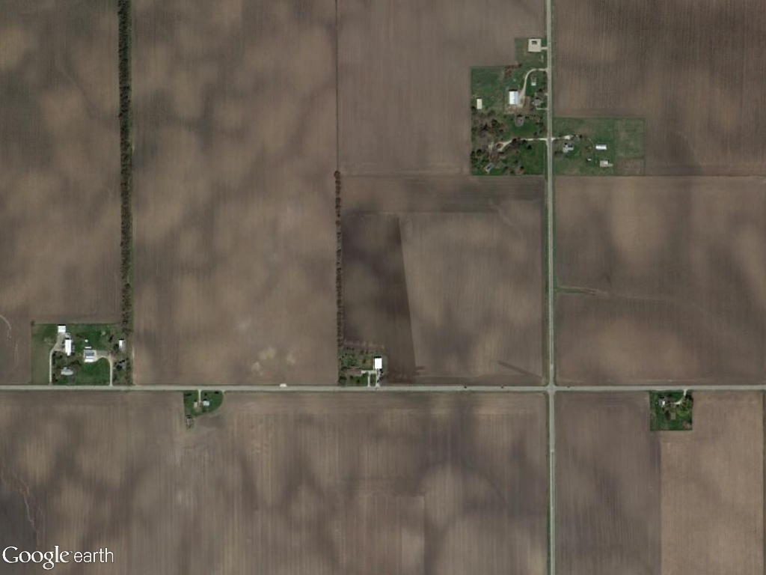
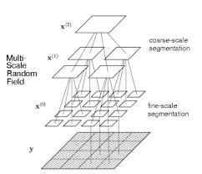
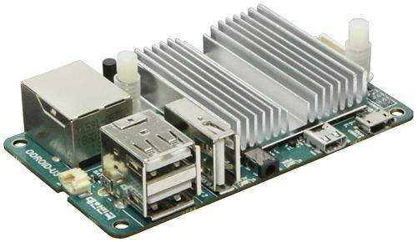
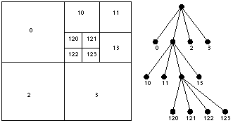
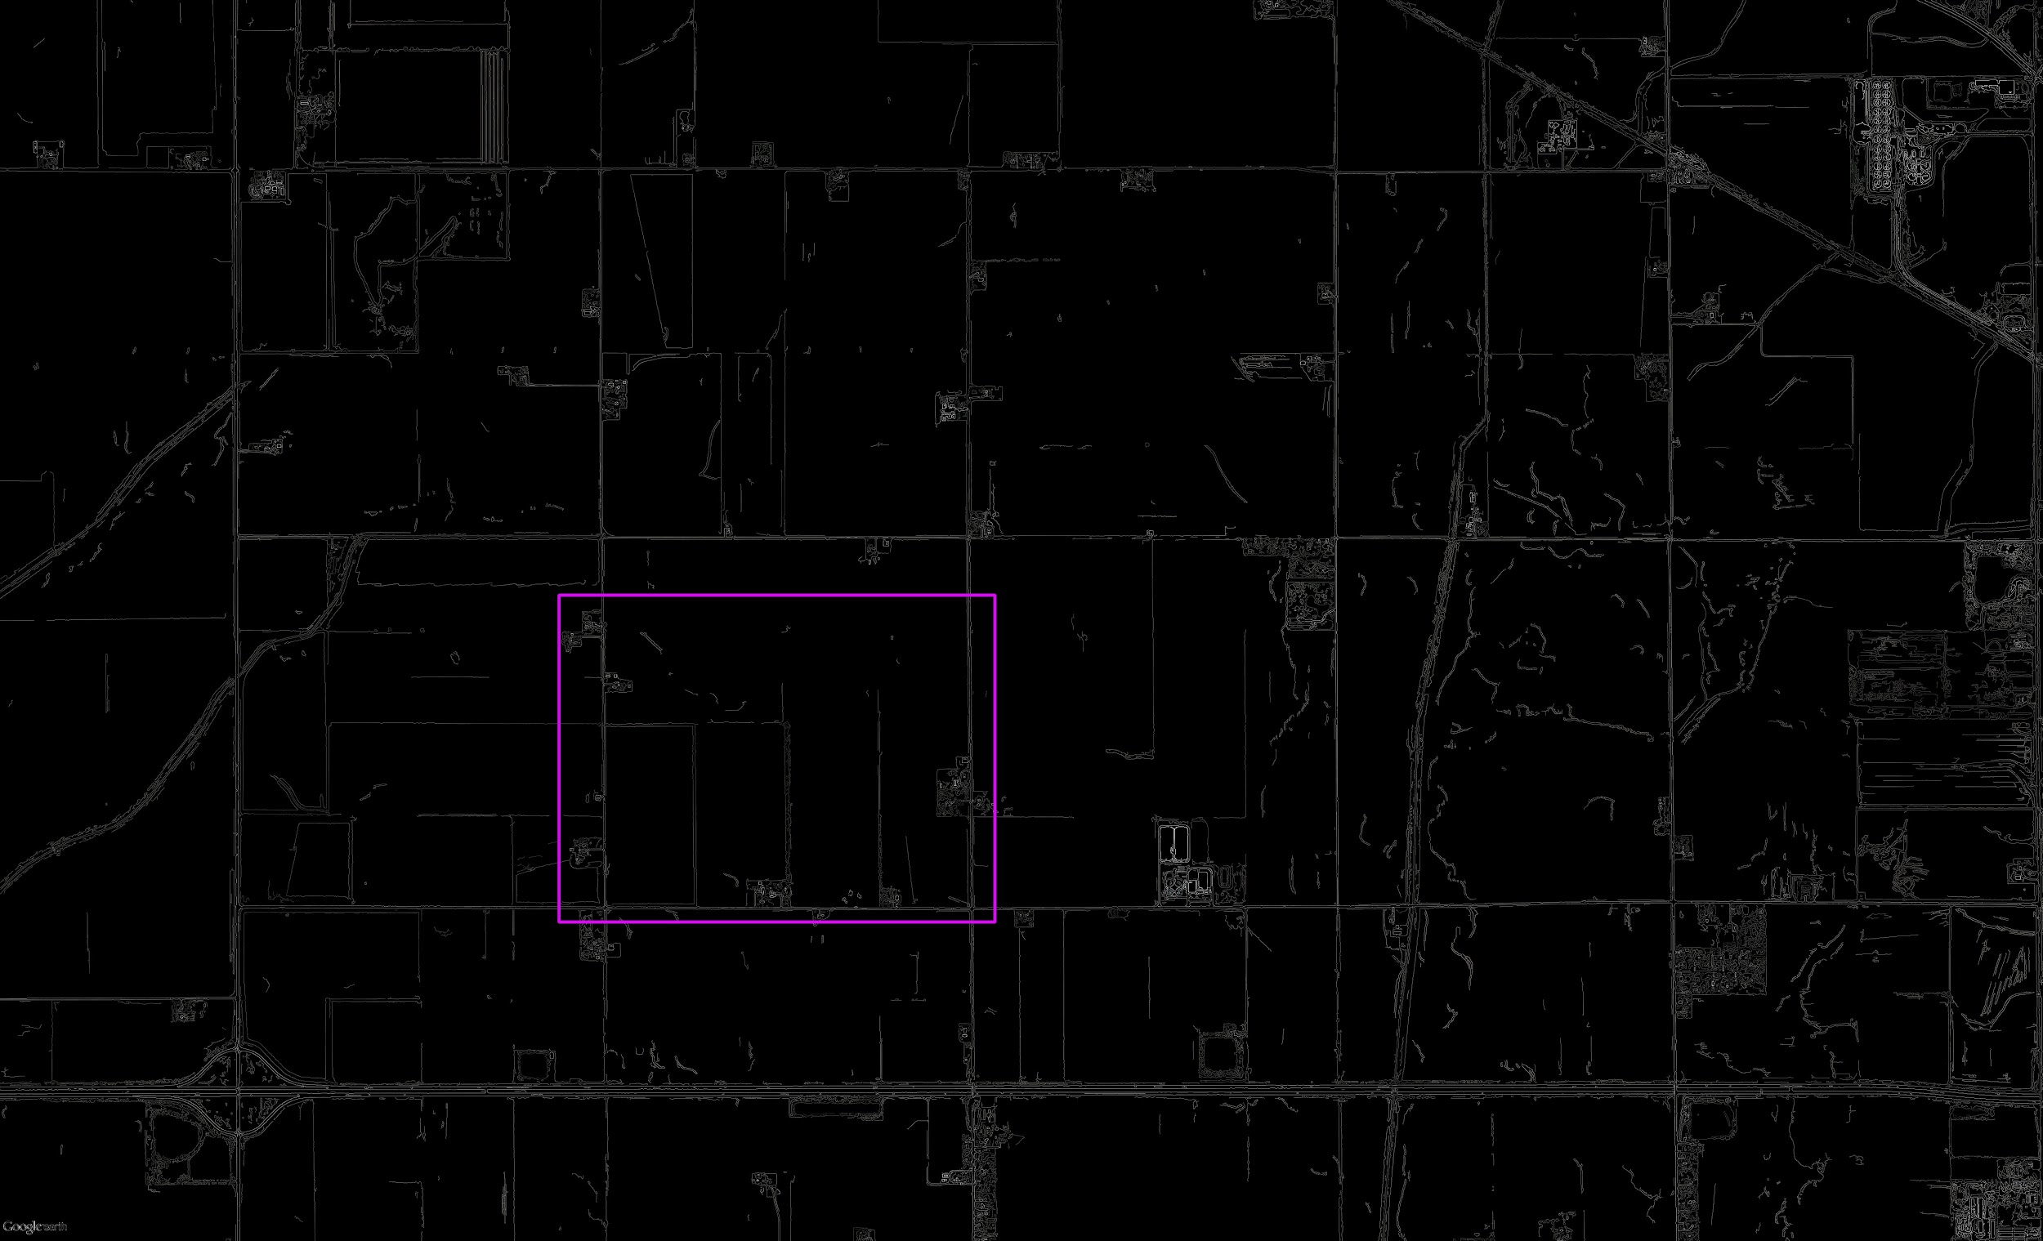
Image Based Navigation System
Fardin Abdi, Tanishq Dubey, Jeffrey Huang and Dongwei Shi
Department of Computer Science , College of Engineering, University of Illinois at Urbana-Champaign
Introduction
UAVs today are assisted by many sensors - GPS, Compass, Sonar - however, these sensors are prone to error or even failure. Our task is to design a system with quite rigid restrictions on computational capacity, power usage, weight, and computational speed, to use machine vision and image processing in order to allow a UAV to find its position based only on a photo it has taken and a database of preprocessed images it has. This feature can be used as either the only method of positioning or can even be used as a fallback method for navigation system.
Method and Storage
Firstly, we have to translate the human readable image to machine readable image. The most efficient way is to use the edge detection method.
Edge Detection and Template Matching
Edge Detection
In order to accomplish useful and accurate Template Matching, a image must first be Edge Detected. This process is quite simply does as it says, it attempts to detect the edges in a image. This is done by first applying a slight Gaussian filter to the image in order to remove noise. This blurred image is thien applied to a Canny Algorithm that finds the points of high relative intensity in an image and returns a greyscale map of this intensity.
Template Matching
The process of finding an image within an image is referred to as template matching. This is accomplished by “sliding” a template image over a source image and recording how well the template matches the source. The location with the best match is the location of the template in the source. In order to make this method work at varying altitudes, our method implements scale invariant template matching. This is done by changing the scale of the source image and continuously matching to find the location of greatest correlation.
Future Work
In order to make the edge detection and storing process more accurate and efficient, we still have to working on the following problems. The first one is to get the accurate greyscale map in a cloudy weather. The most reliable way for us is to lower the altitude of the plane by manipulating the autopilot system. The second problem is to stable the on-board camera by a vertical direction to the ground. Perhaps, we can apply gyroscopes and other subsidiary sensors to control the on-board camera taking photos as soon as it is pointing to the ground.
the left image is an original photograph, the right image is the edge detection applied.
( from:http://en.wikipedia.org/wiki/Edge_detection)
An MQ-9 Reaper, a hunter killer surveillance UAV( from http://en.wikipedia.org/wiki/Unmanned_aerial_vehicle)
After the edge detection we came across another problem. With an embedded system, we have limited resources with both memory and computational power. In order to circumvent this we stored the edge detected images similar to a quadtree structure in physical storage. Splitting images into smaller 100x100 pieces we were able to keep them in directories (NW/SE/SW/NE) and recreated pars of the image as needed instead of searching through the large image in memory by joining the smaller 100x100 parts together.
Results (Images)
A DJI Phantom UAV for commercial and recreational aerial photography ( from http://en.wikipedia.org/wiki/Unmanned_aerial_vehicle)
Results and Conclusions:
Results
As can be seen from the images on the left, our system was able to take raw satellite imagery, and live imagery from the drone and identify where the drone was on a macroscopic scale. These results can be repeated wth high accuracy and can be computed in an acceptable amount of time, allowing a UAV to navigate to its location.
Conclusions:
All in all, we have developed a robust, efficient, and accurate method of finding a UAV’s location based only on offline satellite imagery and photos taken by the UAV itself. This Image Based Navigation System then offers itself to be a powerful component of either a backup navigation system or a primary navigation system. Further testing and analysis needs to be completed in order to guarantee the accuracy of the system and the codebase must be optimized so that the algorithms can run faster, so that latency between when the image is taken and when a location is returned is at a minimum.
Aim
There are two aims. The first aim is to come up with an algorithm which compares the satellite images (from google earth) with current view from UVA’s camera. The second aim is to simplify the algorithm which can run and compile on limited source like, “Odroid board” on UVA
Quadtree representations
http://web.stanford.edu/class/ee368b/Projects/embrya/
Captions set in a serif style font such as Times, 18 to 24 size, italic style.
Duis autem vel eum iriure dolor in hendrerit in vulputate velit esse molestie consequat.
Odroid board which is used on UVA (from http://www.hardkernel.com/main/main.php)
The implementation of how to splicing the tree.
(from:http://upcommons.upc.edu/pfc/bitstream/2099.1/15859/3/exchange_internship_uj.pdf.txt )
Captions set in a serif style font such as Times, 18 to 24 size, italic style.
Duis autem vel eum iriure dolor in hendrerit in vulputate velit esse molestie consequat.

