Slide 1


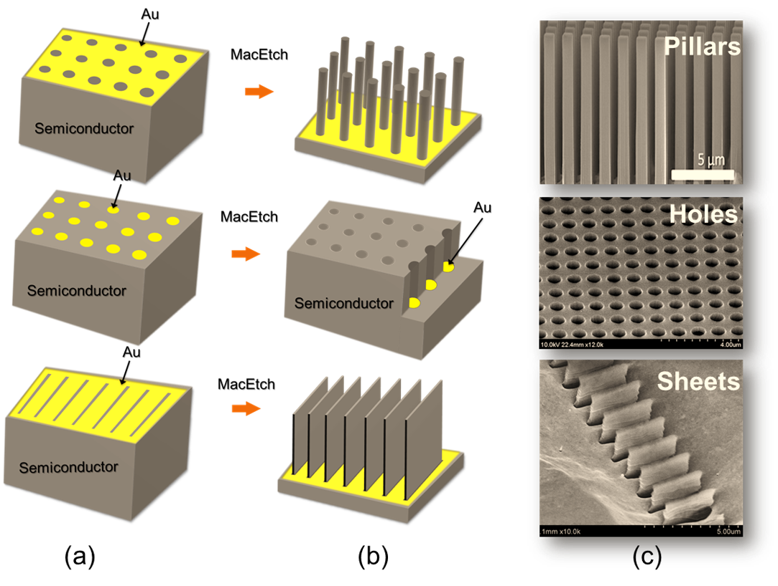
Metal Assisted Chemical Etching (MacEtch)
Haige Chen, Shixin Wu
Mentors: Wen Huang, J. D. Kim, Munho Kim, Professor Xiuling Li
University of Illinois at Urbana-Champaign
Background and Importance
2. Scanning Electron Microscopy (SEM)
After fabrication, we use SEM imaging to determine the quality of etching.
Metal-Asisted Chemical Etching (MacEtch) is a nanofabrication method to produce extremely high aspect ratio semiconductor nanostructures including Si, Ge, GaAs, InP, GaN, homo- and hetero-junctions.
MacEtch is a quite novel technique. Therefore, it is important to learn how to use MacEtch on different materials to produce various nano- and micro-structures that can be used in making devices such as photodetectors, capacitors, transistors, etc. Several factors, such as HF concentration and etching time, play an essential role in the quality of the etching result.
SEM image of two samples
Progress and Goals
Through controlling catalyst type and etching conditions such as etching time, catalyst concentration and temperature in MacEtch process to achieve controlled roughness, high aspect ratio, and non-porosity semiconductor nanostructures.
Our responsibility is to understand the fabrication mechanism, and assist PhD students to optimize the fabrication quality, explore the new methods of the MacEtch and its limits. There are two main type of research works for us to do, which are Fabrication and Electron Microscopy. In this semester, our research group has complete the training in the field of Electron Microscopy, which consists of Scanning Electron Microscopy Imaging (SEM) and Energy Dispersive Spectroscopy (EDS). We inspected the top act of class sectional SEU Image and dimension of MacEtched Sample (Si or III-V), compared the quality of different MacEtched Samples from SEM images, then identified the Nanostructured semiconductor material quality of EDS.
a
Illustration of MacEtch Mechanism and Capabilities
Method
1. Fabrication
MacEtch uses noble metals to induce local oxidation and reduction reactions under open circuit. Metal such as Au, Pt and Ag, deposited on the surface of a semiconductor (e.g. Si) serves as a local cathode to catalyze the reduction of oxidants (e.g. H2O2) producing holes (h+ ). The holes (h+ ) are then injected into the valence band of the semiconductor to oxidize and form the ionic form that is soluble in an acidic solution (e.g. HF). This results in the removal of semiconductor materials without net consumption of the metal.
Under controlled etching conditions, MacEtch reactions occur only at the interface between metal and the semiconductor. As a result, metal descends into the semiconductor as the semiconductor is being etched right underneath, acting as a negative resist etch mask. When the catalyst metal is patterned in any shape and dimension, the pattern can be engraved into the semiconductor to produce micro and nanostructures including arrays of pillars and the inverse holey structures.
Progress and Goals
In next semester, we plan to finish training on fabrication process, and to do the photolithography (resolution ~ 2 micrometer) of Si, III-V substance. Then clean the PR residues by RIE, deposit metal catalysts (Au, Ag...) (<20nm), using e-beam evaporator for metal-assisted chemical etching.
Reference
"Metal-assisted chemical Etching (MacEtch)", Mocvd.ece.illinois.edu, 2017. [Online]. Available: http://mocvd.ece.illinois.edu/research/MacEtch.html.
Xiuling Li, Metal assisted chemical etching for high aspect ratio nanostructures: A review of characteristics and applications in photovoltaics, Current Opinion in Solid State and Materials Science, Volume 16, Issue 2, April 2012, Pages 71-81, ISSN 1359-0286, https://doi.org/10.1016/j.cossms.2011.11.002. (http://www.sciencedirect.com/science/article/pii/S1359028611000830)

