Slide 1



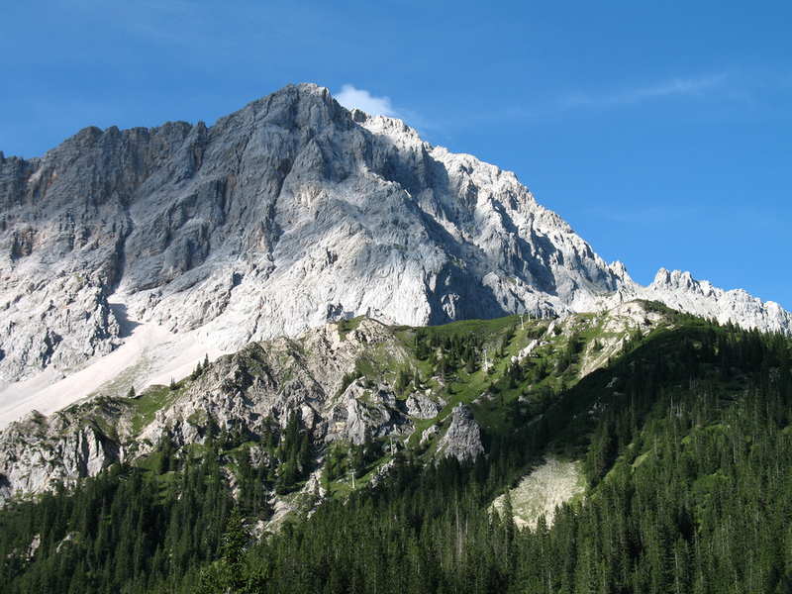
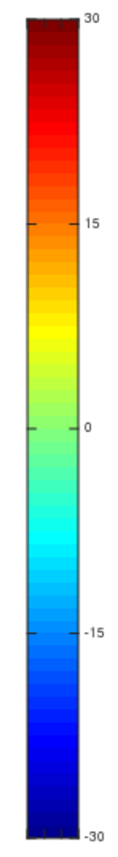
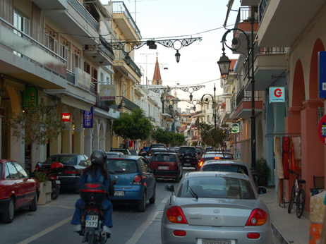
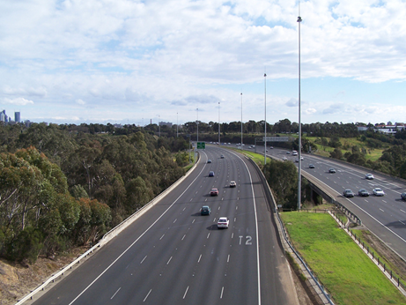
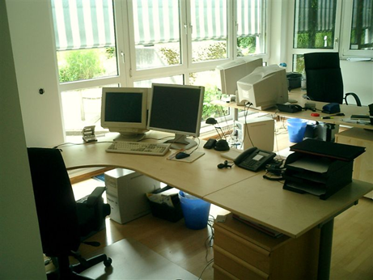
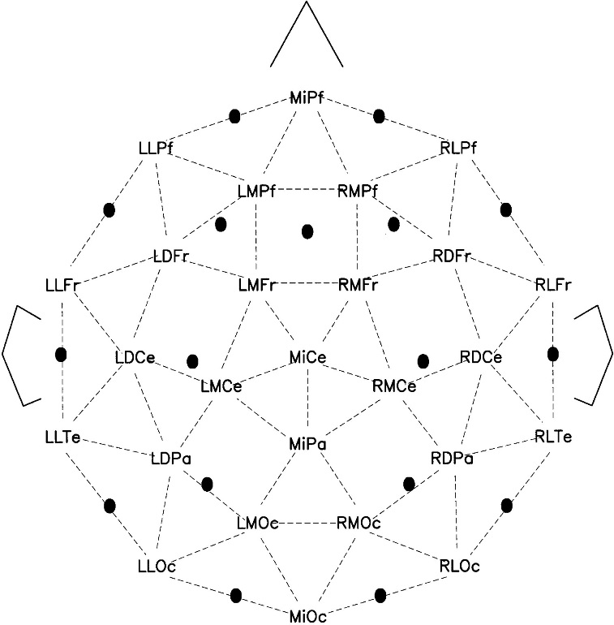

Machine Learning for Visual Scene Classification with EEG Data
Hammad Khan¹, Kush Mittal¹, Cybelle Smith² (Mentor)
¹Department of Computer Science, University of Illinois, Urbana-Champaign, ²Department of Psychology, University of Illinois, Urbana-Champaign
Introduction
In much experimental research using electroencephalography (EEG), hypotheses are formed about the mean amplitude of the EEG signal over predetermined time windows and scalp regions. However, there is also a need for exploratory analyses that might identify new dependent measures (i.e. over new time windows or regions of interest) that correlate well with some aspect of cognition.
The goal of our current set of analyses is to:
Identify new potential dependent measures relevant to visual scene recognition using a data driven exploratory analysis.
Obtain a metric of how well machine learning algorithms can classify single trial data along several dimensions: visual field to which the image was presented, prototypicality of the image, and the type of scene depicted in the image (e.g. beach vs. office). In this way we can also get a metric of how much information can be extracted from select features of the data for potential scientific or BCI applications.
Classification Algorithm: Lasso regression, 10-fold cross validation used to select optimal lambda.
Cross-validation: Additional outer loop of 10-fold cross validation used to assess accuracy of model on held out dataset.
Findings
Scalp Localization of Representative Features: Scalp map represents electrode channel frequencies of features selected from regression model for classifying scenes into left and right visual fields.
Time Domain Histogram of Representative Features: Features characterizing visual processing tend to peak around 100-200ms after stimulus as shown in the figure, similar to latency of N1 effect in ERP waveform.
The features selected by the model peak at 100ms after the event in contrast with the scalp plot differences shown above which peak later on in the epoch.
The figure shows the number of features selected by the regression algorithm in 100ms time intervals. The features localize towards the back of the head indicating involvement of the visual cortex of the brain.
Methods
A logistic regression algorithm is used to train a model to categorize scene classes and differentiate between left and right visual fields.
EEG Dataset: The EEG dataset analyzed was obtained from the Cognition and Brain Lab at the University of Illinois from the recordings of one subject on 26 electrode channels.
Pre-processing: Raw continuous EEG waveforms converted into epoched data intervals (-200-1000ms). Data baselined and low pass filtered (30 Hz cutoff) prior to feature extraction.
Artifact Rejection: Trials with eye blinks, eye movements, or other artifacts were removed prior to analysis.
EEG Analysis: Feature set = z-score of mean EEG for each channel over intervals of 200ms (step size: 40ms) and 40ms (step size: 12ms) from 0 to 1000ms
Scene Categories: Each scene was presented for 200ms from a set of good exemplar scene types as shown above.
The histogram shows the number of representative features selected by the regression model at times after the event. The scalp plots show the difference between left and right visual fields of the ERP waveform at 100ms intervals after the event.
Results & Conclusions
Model Classification Accuracy: Resulting model has an accuracy of 82.38% for optimal lambda and 80.33% for lambda within one standard error.
Conclusion: Selected feature distribution over the scalp was able to isolate class distinction-relevant activity in a way that is even clearer than plotting scalp distribution wave between conditions. This suggests similar machine learning and regularized regression techniques may serve as a useful tool for better understanding high-dimensional, low signal-to-noise ratio data like EEG.
The figure shows the ERP waveform of the EEG recording on the LLOc (left) and RLOc (right) channels for left (red) and right (black) visual events.
The figure on the left shows the positioning of the electrodes on the scalp. The LLOc and RLOc channels described above are highlighted.
Citations
Delorme A & Makeig S (2004) EEGLAB: an open source toolbox for analysis of single-time trial EEG dynamics. Journal of Neuroscience Methods 134:9-21

