Slide 1
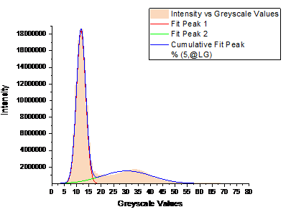
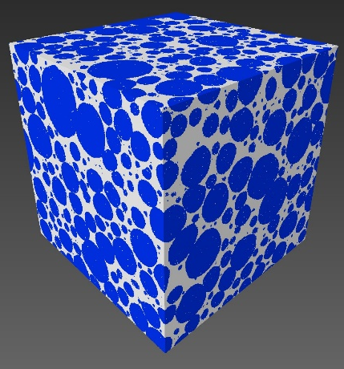
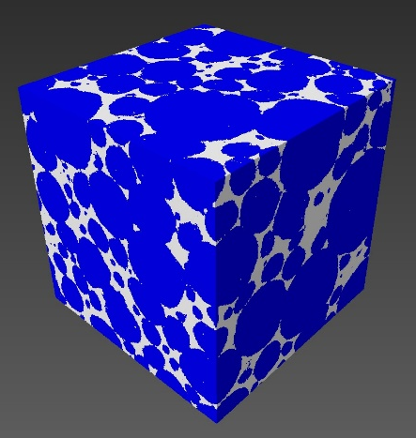
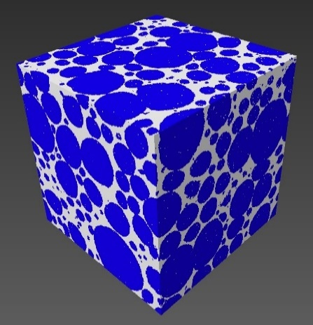
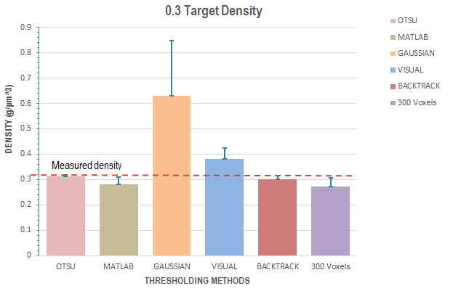
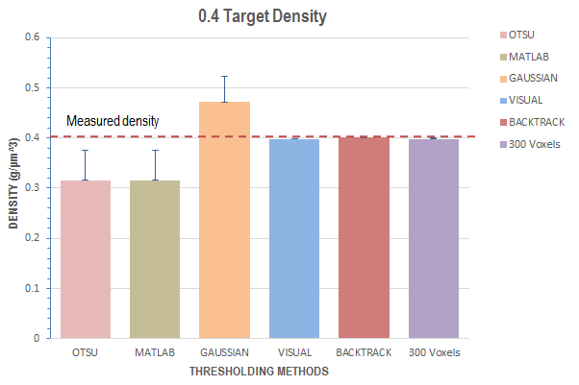
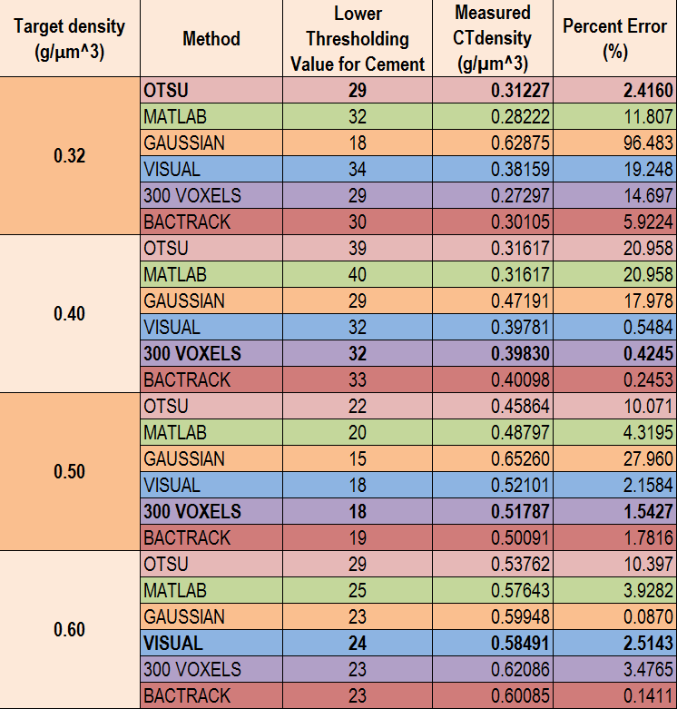
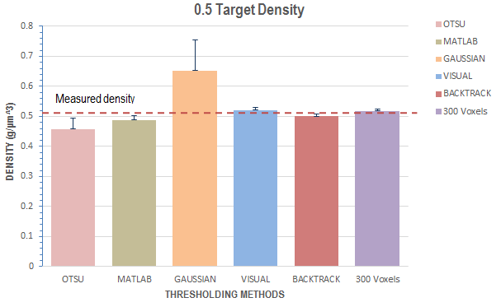
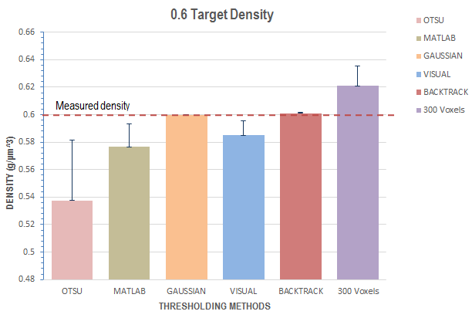
X-RAY COMPUTED TOMOGRAPHY FOR THE
CHARACTERIZATON OF THE
CELLULAR STRUCTURE OF FOAMED CEMENT
LILLIAN BEI JIA LAU
Mentor: Jamie V. Clark
Faculty Advisor: Professor David A. Lange
DEPARTMENT OF CIVIL AND ENVIRONMENTAL ENGINEERING, UNIVERSITY OF ILLINOIS URBANA-CHAMPAIGN
PROJECT BACKGROUND
TECHNIQUE
Understanding cement pore structure is important in improving the durability of concrete.
However, current methods that include:
Scanning Electron Microscopy (SEM)
Transmission Electron Microscopy (TEM)
Mercury Intrusion Porosimetry (MIP)
yield incomplete results and require extensive sample preparation.
X-Ray CT is a non-invasive imaging technique which requires minimal sample preparation.
Specific greyscale values collected from the CT data are used as thresholds to determine the percentage of pores and cement.
The current method of visually segmenting pores from the cement to obtain the greyscale threshold value may be inaccurate due to its subjectivity.
We applied six different methods of thresholding the greyscale values of foamed cement of four different densities.
Possible methods for determining thresholding values in CT data segmentation were identified:
The 16-bit images from the CT scan of four different densities of foamed cement were converted to 8-bit images with greyscale values ranging from 0 (black) to 255 (white) in AMIRA.
Otsu’s method | Visual segmentation
MATLAB programming | 300 voxel sample sizing
Gaussian deconvolution | Backtracking (control)
The different threshold values of each method was applied the foamed cement to reconstruct its density and its 3D structure using the resultant material statistics in AMIRA software.
Fig.3: 0.6 Density
16-bit image
Fig.4: 0.6 Density
8-bit image
RESULTS
The different thresholding methods produced mixed results.
Fig.1: Sample preparation
Pores
PROBLEM STATEMENT
What is the best method to determine thresholding values in foam cement characterization?
Fig.5: 0.3 Density 3D Model (Gaussian), Poorest
Fig.6: 0.6 Density 3D Model (Gaussian), Best
Threshold value=16
Cement
Fig.2: X-Ray Intensity vs. Greyscale Values for 0.5 Density Foam Cement using Gaussian Deconvolution
Fig.7: 0.4 Density 3D Model (300 Voxels), Best
Fig.8: 0.5 Density 3D Model (300 Voxels), Best
Fig.10: Graphs of Densities vs Thresholding Methods
Table 1: Comparison of accuracy of different thresholding methods
The Gaussian curves also did not perfectly fit due to the non-normal distribution of the two phases.
To reduce future errors, more samples should be taken to make up for the small sample size.
DISCUSSION
CONCLUSION
At 500 voxels, the method that yielded the most consistent results was the visual method.
The thresholding methods that gave the best densities yielded models with ‘cement’ inside the pore space.
The sample size was reduced to 300 voxels, which resulted in the most accurate reproduction of the densities.
These conflicting results could be due to the small sample size and noise interference.
The study was unable to conclusively determine one best method to threshold foam cement X-Ray CT data.
However, the variability of the more objective thresholding methods showed that the best way to consistently analyze the CT data of the foamed cement is visual segmentation.
Further studies have to be carried out using a volume of 300 voxels in AMIRA to improve accuracy.
REFERENCES
Bossa, N., Chaurand, P., Vicente, J., Borshneck, D., Levard., C., Aguerre-Chariol, O., Rose., J. “Micro- and Nano-X-ray computed tomography: A step forward in the characterization of the pore network of a leached cement paste.” Cement and Cocrete Research 67, 2017.
Nambiar, E.K.K., Ramamurthy, K. “Air void characterization of foam concrete”. Cement and Concrete Research 37, 2007.
Zhang, M., He, Y., Ye., G., Lange, D.A., Bruegel., K. “Computational investigation on mass diffusivity in Portland cement paste based on X-ray computed microtomography (µCT) image.” Construction and Building Materials 27, 2012.
Fig.9: 0.6 Density 3D Model (Gaussian), Best

