Slide 1
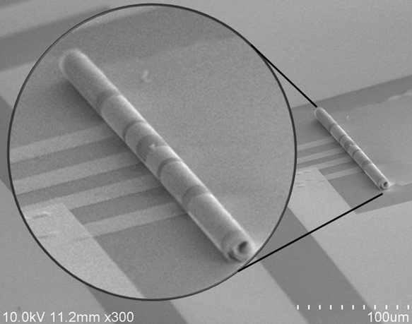
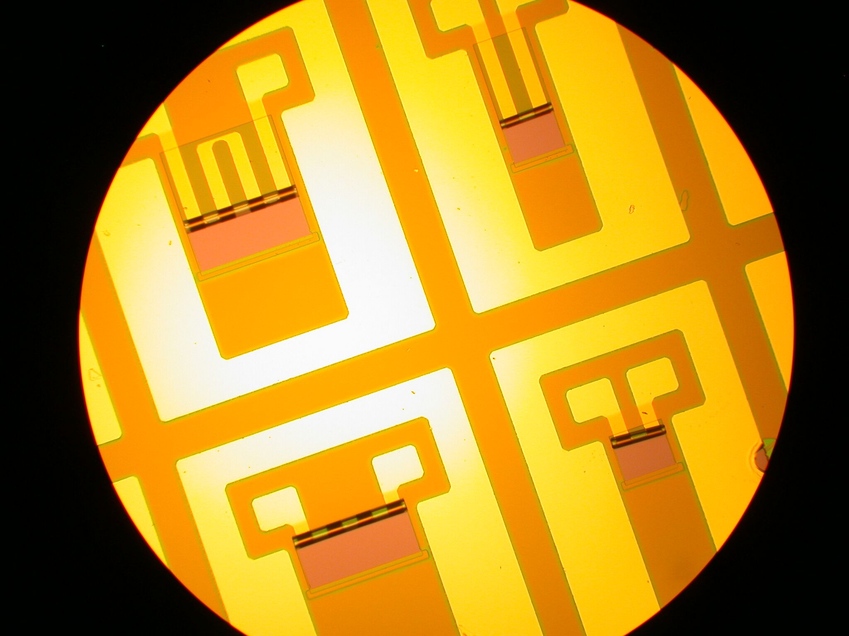
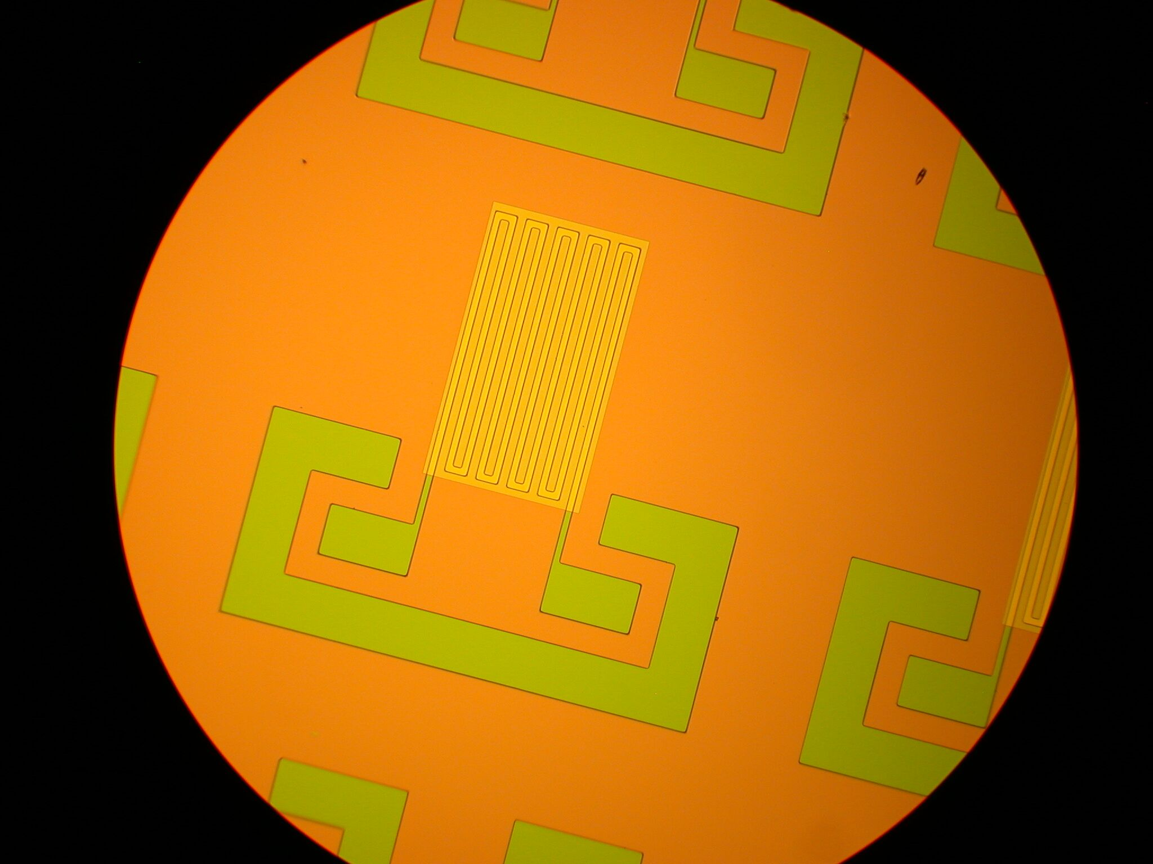
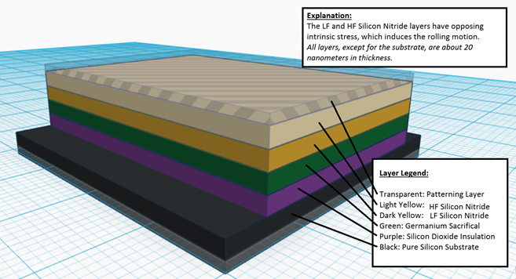
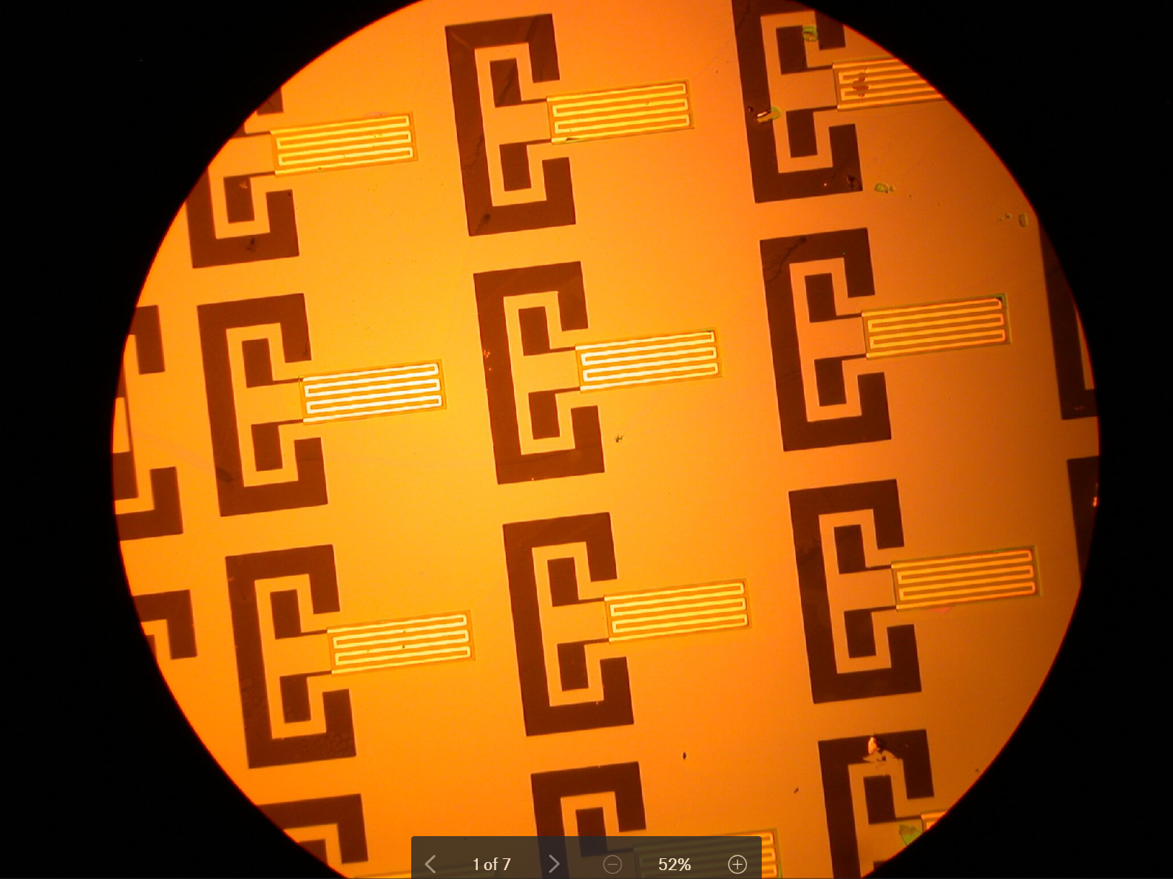
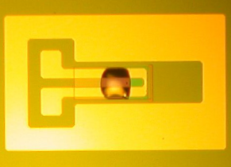
UIUC PURE
Mentor: Wen Huang
PI: Professor Xiuling Li
Mentees: Qingyi Wang, Mark Kraman
Self Rolled-Up Membrane Technology (S-RuM)
Core Technology
Image to the left:
This image shows an inductor sample after it has been rolled up. The inner diameter of this devices is in the range of 20 μm.
Image credit: Wen Huang
The S-RuM platform technology utilizes an oppositely-strained thin film Si_{x}N_{y} bilayer to induce a rolling motion of the material, allowing the creation of 3D device architectures using 2D nanofabrication processes.
Left Image: A top-down view of S-RuM inductors at different stages of the rolling process.
Image Credit: Mantian Xue.
Center Image: The 2D pattern of a 5-cell inductor before copper deposition. Note the color differences representing different materials on the sample: Green- Germanium, Yellow - Si_{x}N_{y}, Purple - SiO₂.
Right Image: A layer-by-layer breakdown of the device before rolling, excluding patterning and etching steps.
Advantages
High Power Density
Low On-Chip Footprint
CMOS Compatible Fabrication
High Mutual Inductance
Minimal Unintended Substrate Coupling
Mechanically strong, relative to current alternative 3D devices
Ambition
While active electronic components have undergone drastic miniaturization according to Moore’s Law, passive components have followed no such trend.
However, through the S-RuM platform, a breakthrough miniaturization trend is possible. This research focuses on the development of a Copper alternative to the current Gold S-RuM inductors. Copper has the lowest resistivity of all available materials, at the lowest cost.
The primary goal of this research is to determine the thickness of copper traces that provide the highest Q-factor without imposing mechanical resistance to rolling to the device.
Goals
Produce devices with varying thicknesses of copper, test and compare performance
Seek solutions to common fabrication issues, such as the formation of pinholes in Si_{x}N_{y}
Determine and understand common modes of failure during fabrication
Scope
5G Wireless Communication
High Frequency Power Transformation Devices
Capacitive Devices
Above Images:
Two modes of failure, copper trace oxidation (left image), and pinholes (right image, Image Credit: Mantian Xue). Pinholes are layer-penetrating holes common in thin film Si_{x}N_{y}.
Our greatest gratitude towards our mentor Wen Huang, Professor Xiuling Li, the entire S-RuM group , MNTL staff, and P.U.R.E for their attention and guidance. Finally, thank you to NSF EEC 1449548 for making this work possible.
Notes:
22”x34”

