Slide 1
Vision Based UAV Landing
Raimi Shah
Mentor: Or Dantsker

Slide 2
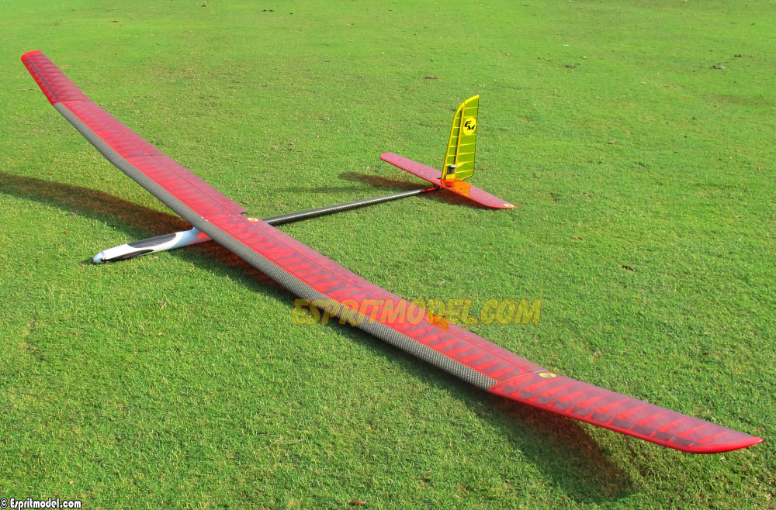
Motivation
Lab is developing solar powered aircraft
Must maximize efficiency by minimizing energy consumption
Aircraft has no landing gear → less weight → less drag → less energy consumed
Since aircraft is large and fragile, it cannot land using conventional means
Will use a 15’x15’ net to catch the aircraft
Wingspan:
157.5”
(4.00 m)
Length:
70.0”
(1.78 m)
Weight:
4.4 lb
(2.0 kg)

Slide 3
Overview
Use computer vision to determine the aircraft’s location relative to the landing net
Write code in C++ using OpenCV libraries to detect the target frame and calculate the (x,y,z) distance
Target frame will hold the net and be bright orange, making it easily distinguishable from the background
Once distance can be accurately calculated, the code will be integrated into the UAV flight computer, providing the autopilot relative aircraft location during landing
Will also profile GPU/CPU (frame rate vs power consumed)

Slide 4
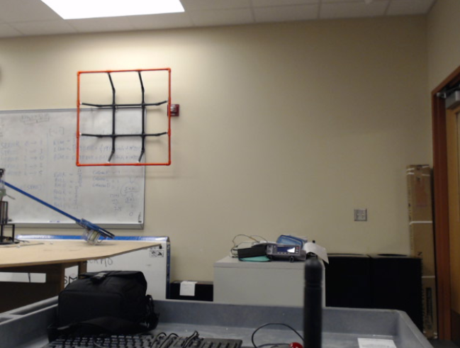
Technique
Filter image and detect the target
Detect the target contours, producing target outline
Use the largest outline to represent the target
Use a data type ‘RotatedRect’ to bound the contour, producing target information including: area, vertices, width and height
Compute distance to the target using:
Distance = (actual Width x Focal Length†) / image Width
Compute x, y, z offset from the center of the target
Once the camera is close enough that outer frame disappears, a smaller marker placed in the center will be tracked until a landing is completed
† Focal Length is pre-computed in camera pixels using a known distance

Slide 5
Goals
Color calibration for object detection for orange frame ✓
Small scale model in lab ✓
Calculate distance to target in z-direction ✓
Frame rate profiling ✓
Calculate distance to target in x- and y-directions
Process real-world video of the landing target to verify code
Create interface with flight control board
Deploy onto aircraft

Slide 6
Questions?

