Slide 1
Attack and defense on learning-based security system
mentor: wei yang
mentee: Ximin lin

Slide 2
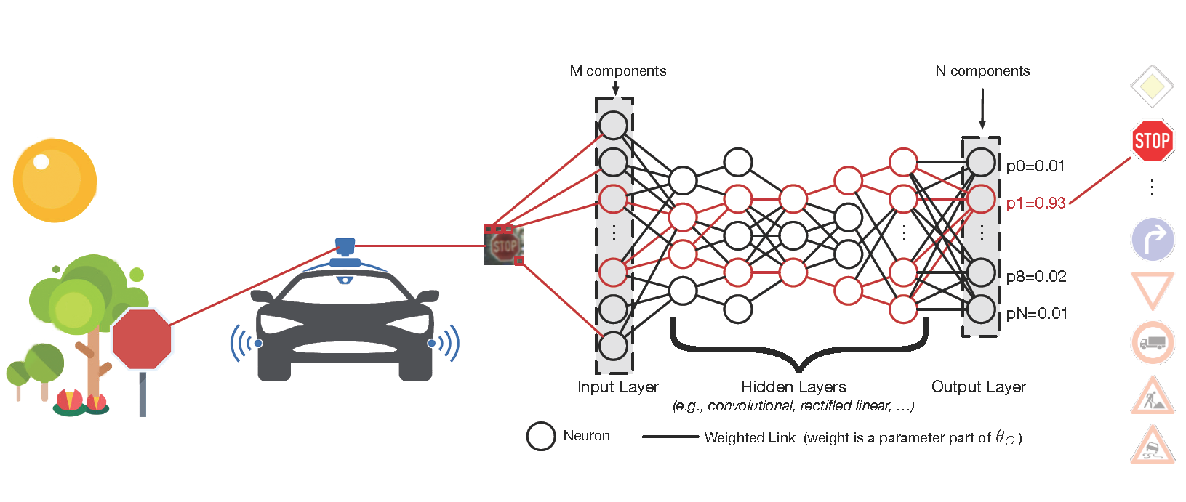
Deep Neural Networks
Notes:
boy who cried wolf

Slide 3
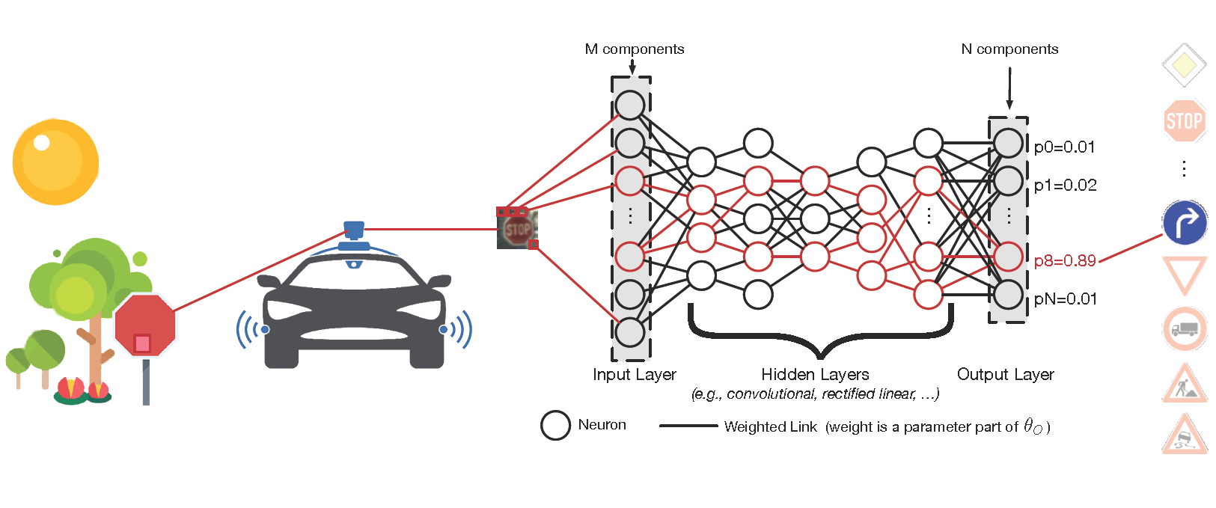
Deep Neural Networks

Slide 4
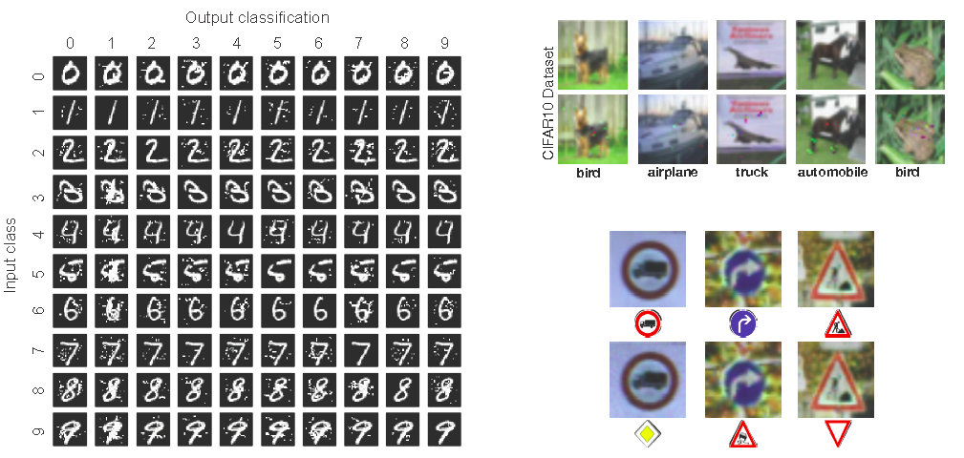
It is possible to fool the deep-learning system

Slide 5
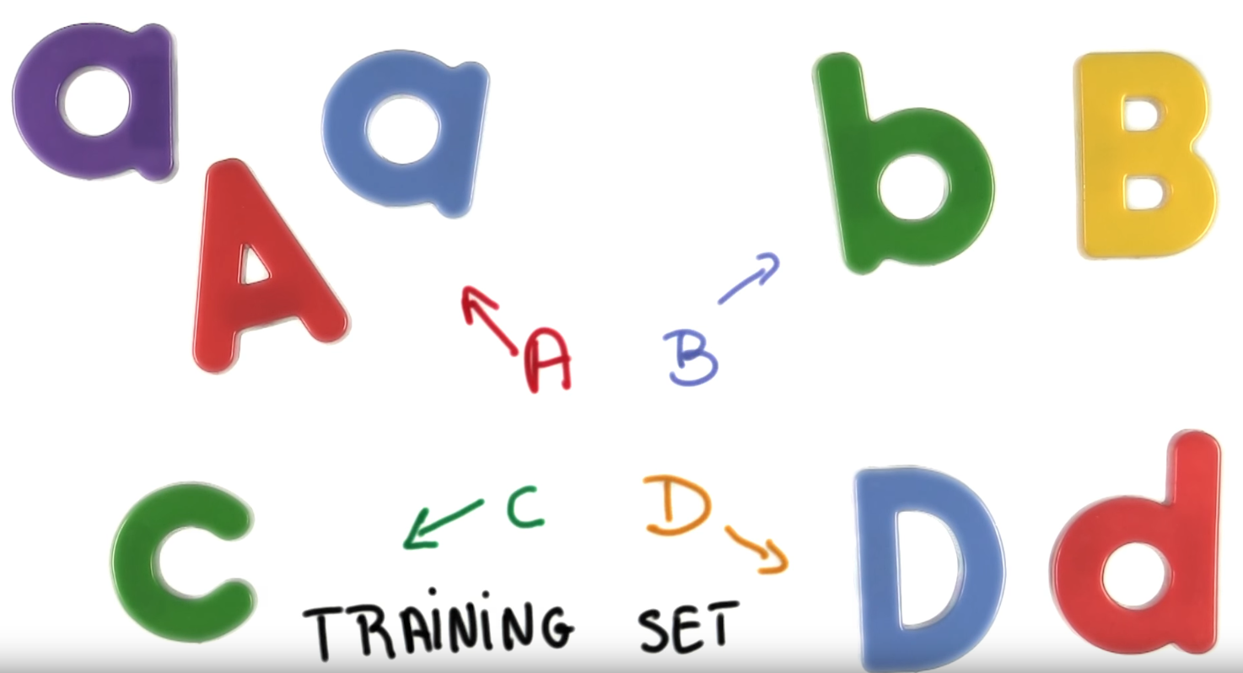
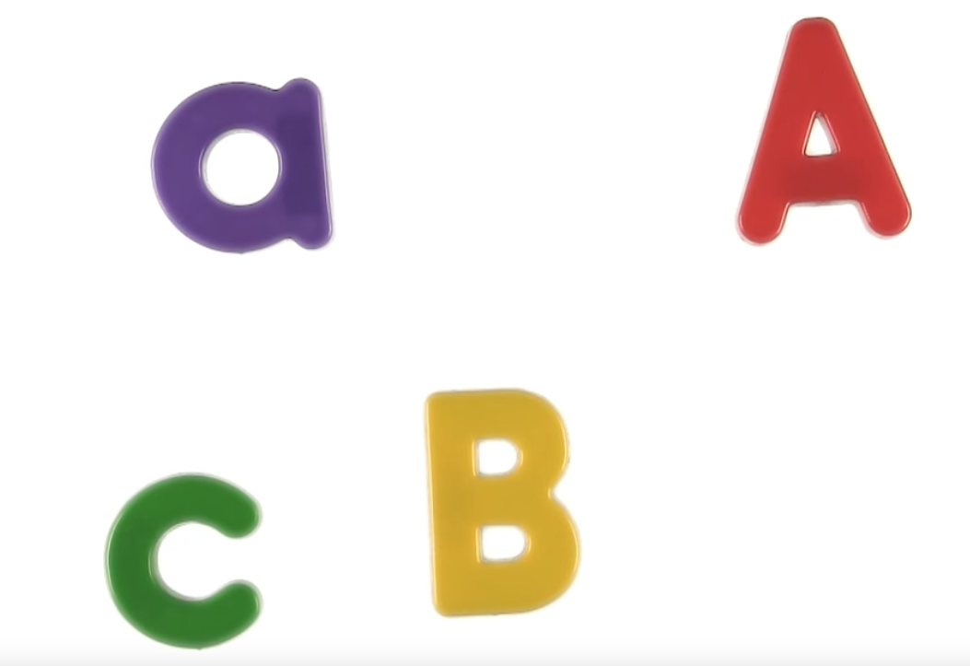
Preliminary study - Identify characters in the image

Slide 6
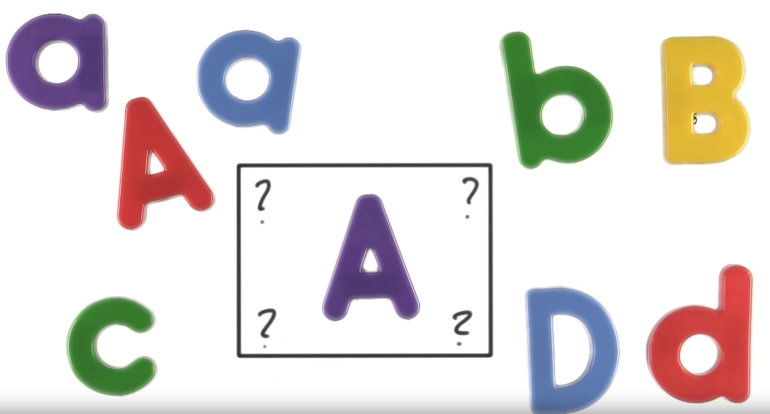
Preliminary study - Identify characters in the image

Slide 7
Preliminary study – Crafting adversarial samples
We try to implement the adversarial crafting part with images of letters from A to J (10 letter labels for data)
For simplicity, we directly adopted the deep neural network with three hidden layers provided in Tensorflow tutorial
We use images from MNIST dataset to train and test our models. Each sample from MNIST dataset is a 28 by 28 gray-scale image (R, G, B values are the same from 0 to 255). We compress the image to 1 by 784 array (28 x 28 = 784).

Slide 8
first project in image crafting(II)
For each training, we randomly pick 50 samples with proper labels from MNIST dataset and find the appropriate weights and biases parameters for us
We train the model for 20000 times (suggested in tutorials), which gives us the final accuracy around 100%
The general idea of adversarial crafting is to minimize the change, denoted ∆x, we made to the original sample, while making the largest change in final softmax matrix so that model will misclassify:
(2)

Slide 9
current Progress:
Study the use of softmax, pooling, convolution, cross-entropy, RELU function, and backpropagation in building neural network
Study functions like early termination, regularization, dropout to prevent over-fitting
Study the analysis of different techniques adopted to decrease misclassification rate:
feature reduction(simple feature reduction, via mutual information)
distillation
re-training
Based on the image classification model provided in Google Tensorflow tutorial, and algorithms described in paper “The Limitations of Deep Learning in Adversarial Settings ” , we have implemented algorithms that can fool the almost 100% accurate model.

Slide 10
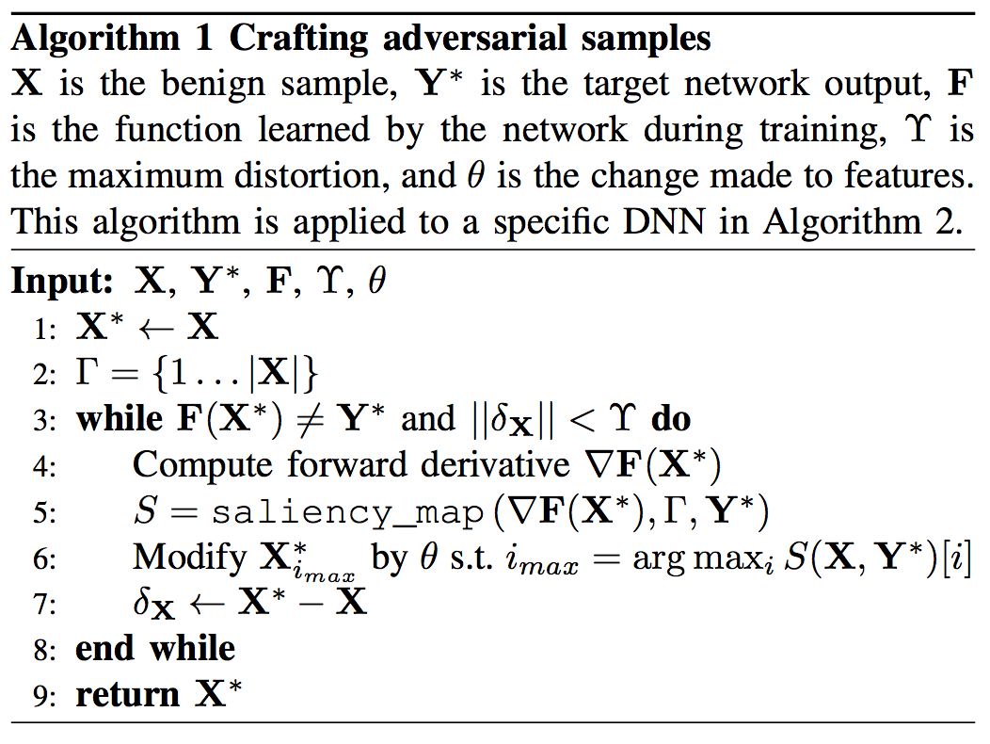
first project in image crafting(III)
First algorithm: edit the pixel that can make the largest change in classification

Slide 11
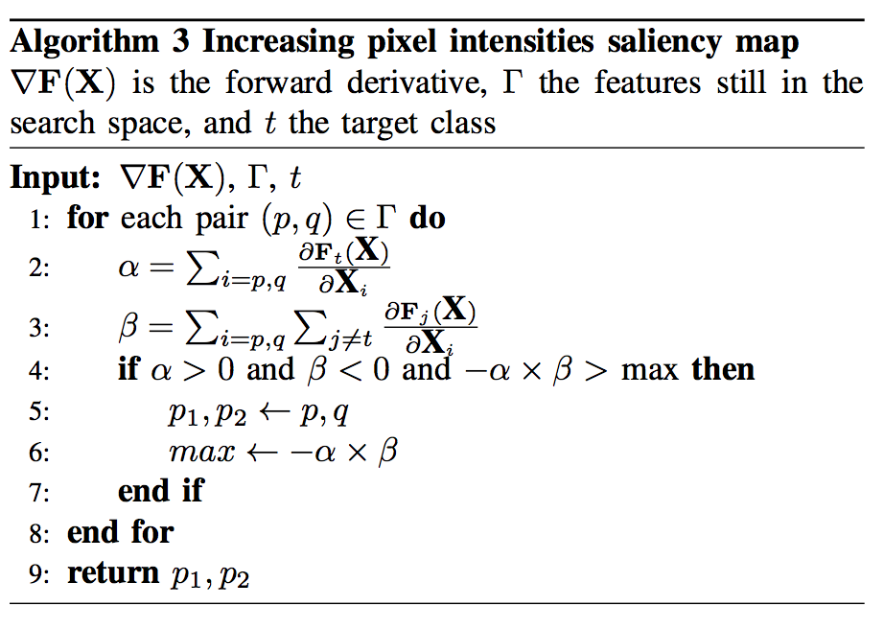
first project in image crafting(IV)
Second algorithm: pick up the most “valuable” pixel, and tell the first algorithm which pixel to change

Slide 12
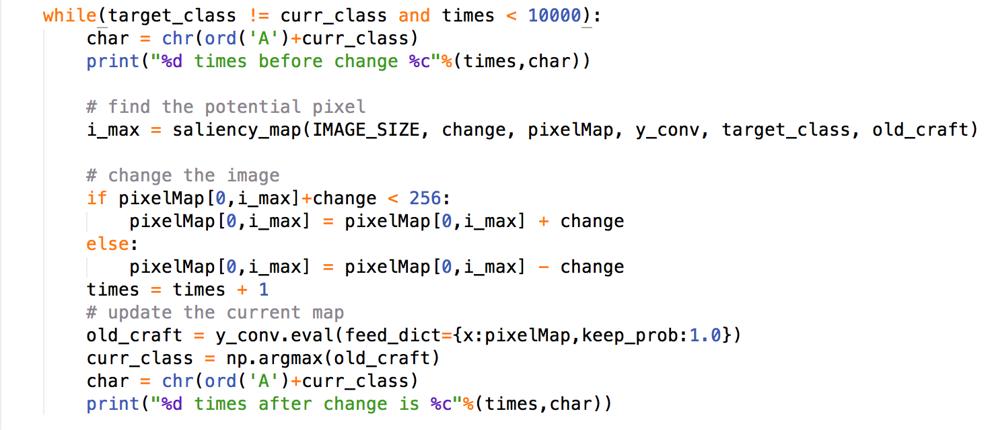
first project in image crafting(V)
Our implementation and understandings of first algorithm

Slide 13
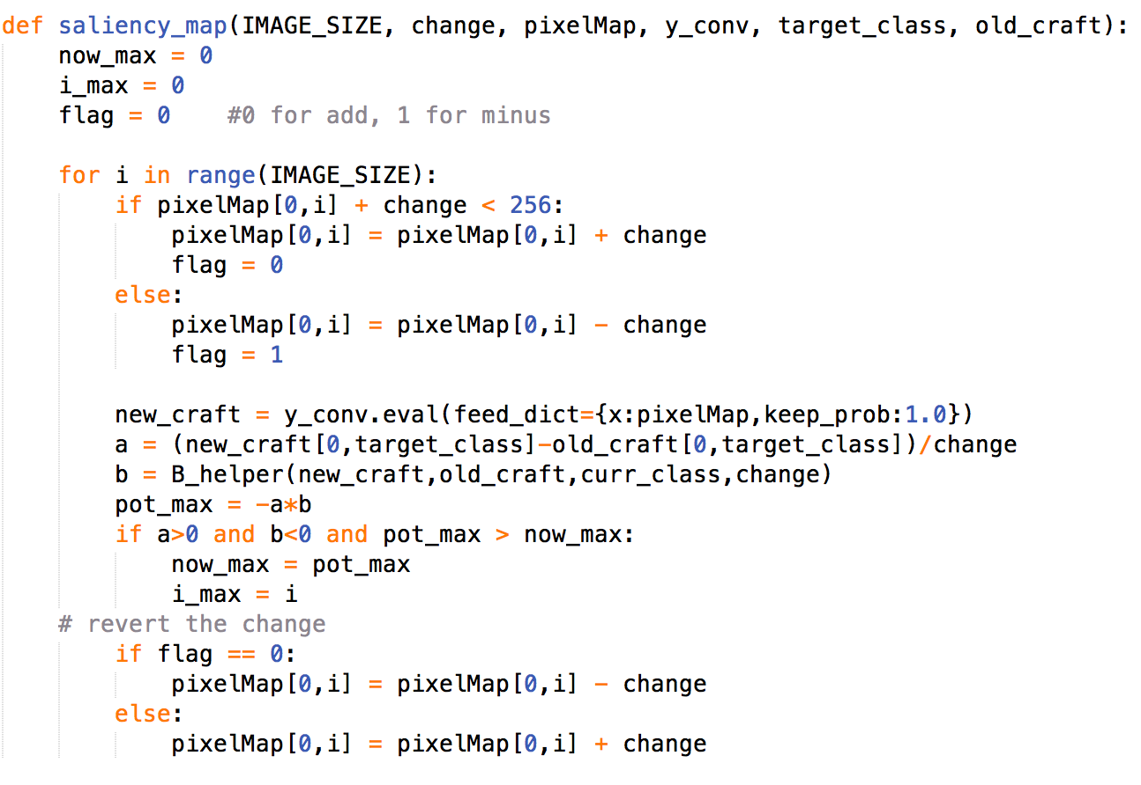
first project in image crafting(VI)
Our implementations and understandings of the second algorithm
we use a fixed change instead of derivative to find the most valuable pixel

Slide 14
original
difference
modified
classify to I
classify as I

Slide 15
original
difference
modifed
classify as B
classify as D
classify as F

Slide 16
Result (delta as 50)
target_class(from A) | first image(pixels count) | second image | third image | fourth image | total pixel counts | average pixel counts
B | 1 | 4 | 1 | 2 | 8 | 2
C | 2 | 2 | 2 | 2 | 8 | 2
D | 1 | 1 | 1 | 1 | 4 | 1
E | 4 | 4 | 4 | 2 | 14 | 3.5
F | 1 | 1 | 1 | 1 | 4 | 1
G | 2 | 2 | 3 | 2 | 9 | 2.25
H | 2 | 2 | 2 | 2 | 8 | 2
I | 4 | 4 | 4 | 4 | 16 | 4
J | 1 | 1 | 1 | 1 | 4 | 1

Slide 17
Result (delta as 50)
target_class(from A) | first image(pixels count) | second image | third image | fourth image | total pixel counts | average pixel counts
B | 1 | 1 | 1 | 1 | 4 | 1
C | 1 | 1 | 1 | 1 | 4 | 1
D | 1 | 1 | 1 | 2 | 5 | 1.25
E | 1 | 2 | 3 | 2 | 8 | 2
F | 1 | 1 | 2 | 2 | 6 | 1.5
G | 2 | 2 | 2 | 5 | 11 | 2.75
H | 1 | 1 | 1 | 2 | 5 | 1.25
I | 4 | 100(fail to fool) | 5 | 5 | 14 | 4.6667
J | 2 | 2 | 2 | 2 | 8 | 2

Slide 18
Result (delta as 50)
target_class(from A) | first image(pixels count) | second image | third image | fourth image | total pixel counts | average pixel counts
B | 2 | 1 | 2 | 1 | 6 | 1.5
C | 1 | 2 | 1 | 1 | 5 | 1.25
D | 1 | 2 | 2 | 2 | 7 | 1.75
E | 4 | 4 | 3 | 3 | 14 | 3.5
F | 1 | 1 | 1 | 2 | 5 | 1.25
G | 2 | 2 | 1 | 2 | 7 | 1.75
H | 1 | 1 | 2 | 1 | 5 | 1.25
I | 100(fail) | 2 | 6 | 2 | 10 | 3.333
J | 4 | 4 | 1 | 3 | 12 | 4

Slide 19
Conclusion
The crafting algorithm is very effective in attacking our rather simple model
The final purpose of this practice is to make analogy with crafting adversarial codes for malware detection models

Slide 20
Current issues
Limitations of moving from continuous analysis in image processing to discrete analysis in malware detection due to:
small entropy of input data
difficulties to edit the program so that not disrupting its malicious functionality
Some aspects in the paper remains unclear, so we made a little revisions to the algorithms.

Slide 21
The rest of semester
We will use python script to edit the programs so that our malware can fool the deep learning model.
We will use Weka, an open software that will check the malware for us, to check whether the malware crafted is defined as benign.
Read more papers about algorithms that can strengthen the robustness of our deep learning model.

Slide 22
Reference
Papernot, Nicolas, Patrick McDaniel, Somesh Jha, Matt Fredrikson, Z. Berkay Celik, and Ananthram Swami. "The limitations of deep learning in adversarial settings." In Security and Privacy (EuroS&P), 2016 IEEE European Symposium on, pp. 372-387. IEEE, 2016.
Papernot, Nicolas, Patrick McDaniel, Xi Wu, Somesh Jha, and Ananthram Swami. "Distillation as a defense to adversarial perturbations against deep neural networks." In Security and Privacy (SP), 2016 IEEE Symposium on, pp. 582-597. IEEE, 2016.
McDaniel, Patrick, Nicolas Papernot, and Z. Berkay Celik. "Machine learning in adversarial settings." IEEE Security & Privacy 14, no. 3 (2016): 68-72.
Sharif, Mahmood, Sruti Bhagavatula, Lujo Bauer, and Michael K. Reiter. "Accessorize to a crime: Real and stealthy attacks on state-of-the-art face recognition." In Proceedings of the 2016 ACM SIGSAC Conference on Computer and Communications Security, pp. 1528-1540. ACM, 2016.
Kurakin, Alexey, Ian Goodfellow, and Samy Bengio. "Adversarial examples in the physical world." arXiv preprint arXiv:1607.02533 (2016).
Google Tensorflow Tutorial for experts

