Slide 1
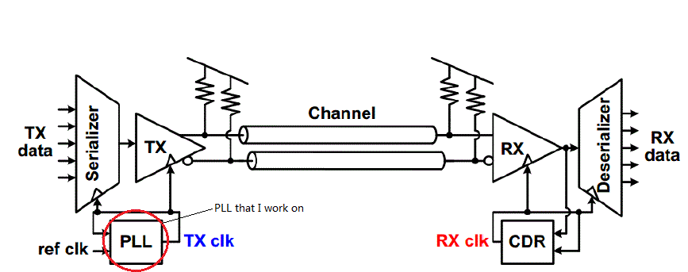
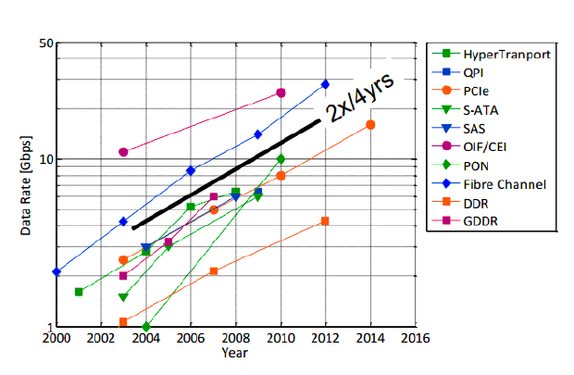
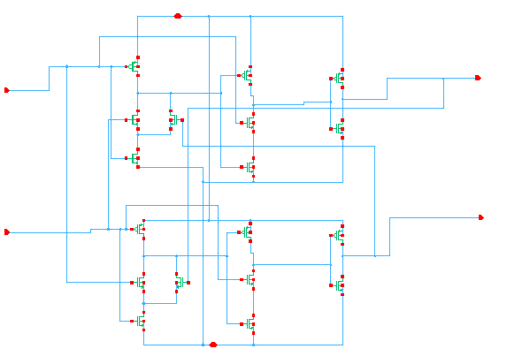
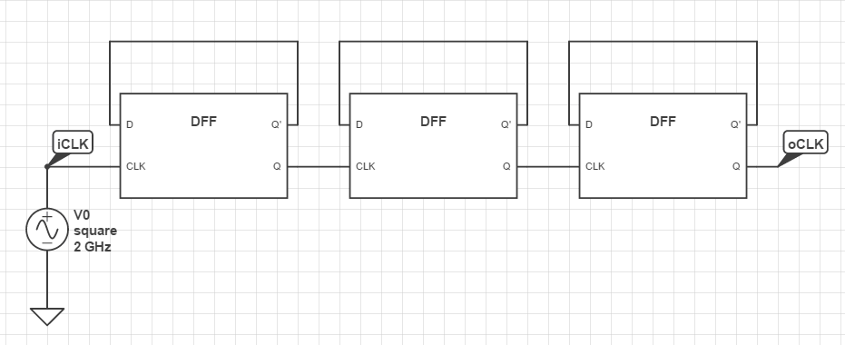
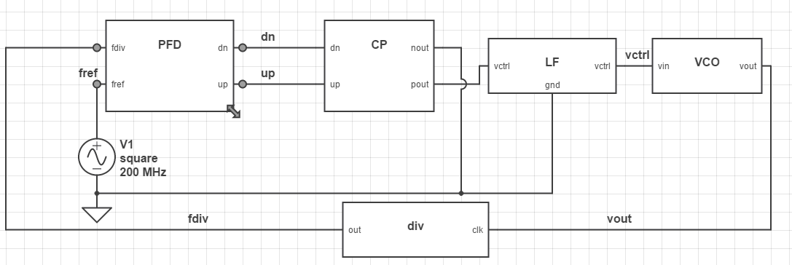
DESIGN AND SIMULATION OF A PHASE LOCKED LOOP
FOR HIGH SPEED SERDES
Yi Zhu
Mentor: Ishita Bisht Advisor: José E. Schutt-Ainé
Motivation
PLL background
The demand for high data-rate interfaces has increased dramatically. This necessitates the use of PLLs for on-chip high frequency clock synthesis.
This research focus on the process of design and simulation for clock divider and phase-frequency detector for PLL in both behavioral level and transistor level.
Simulation process is essential to test the integrity, stability and robustness of the design.
Cadence Virtuoso is used as the hardware design and simulation platform.
High-Speed
SerDes Link Block Diagram
A Phase-Locked Loop (PLL) is a negative feedback system
The purpose is to generate a local clock such that the higher frequency output clock is matched in phase with the input clock
Typical PLL Based Clock-Generator Block Diagram
Clock divider: Essentially divides the higher frequency VCO clock to match the input reference clock.
Phase-frequency detector(PFD): Compares the reference clock signal and the VCO output clock in both phase and frequency. Generates the error signals which are used to achieve lock.
Circuit Design
These are transistor level schematic designs for divider and PFD and all the basic components are implemented in 180 nm CMOS.
These are the behavioral level schematic designs for the PLL.
My work includes the divider and phase-frequency detector in behavioral and transistor level design.
Simulation waveform
Transistor level:
Simulation waveform
for Divider and PFD in
transistor level design
Clock Divider
Fin=2 GHz
N=8
Fout=250 MHz
PFD
Generates UP and DWN
error pulses
Behavioral level:
Simulation waveform
for PLL
The control voltage is
0.4V
The operation frequency
is 6 GHz
The reference frequency
is 200 MHz
PLL Lock time is 350ns
PLL Simulation Waveform
Clock Divider (Divide by 8)
Phase-Frequency detector
Clock Divider Simulation Waveform
PFD Simulation Waveform
Skills gained and Future work
Skill gained:
Design and simulation process of Cadence Virtuoso
System level understanding of PLLs
Verilog AMS programming for behavioral simulation
Future work:
Design and simulate CP, LF and VCO
Implement different architectures for a higher clock speed
Lock Achieved
Reference:
[1] Razavi B. “Design of Monolithic Phase-Locked Loops and Clock Recovery Circuits-A Tutorial.” Retrieved from http://www.ee.ryerson.ca, pp.15,16
[2] Ratan R.(2014). “Design of a phase locked loop based clocking circuit for high speed Serial link applications.” pp1-4,5, 17-21

